Slide 1



DataCleaningAgent
An Agentic AI Workflow built using n8n and LLMs
By Taruni-23071A05N6

Slide 2

Problem Statement
Organizations and individuals often work with large, messy datasets containing missing, inconsistent, or invalid values.
Manual data cleaning is time-consuming, repetitive, and prone to human errors.
Different people may apply inconsistent rules or methods, reducing data reliability.
There’s a need for an intelligent automation system that can clean, validate, and summarize data with minimal human effort.

Slide 3

System Overview
DataCleaningAgent is an AI-powered automation implemented in n8n that:
Reads data from Google Sheets.
Uses multiple specialized agents (Imputer, Validator, Summarizer).
Routes data intelligently via an Orchestrator Agent.
Writes cleaned and annotated rows back into Sheets.

Slide 4
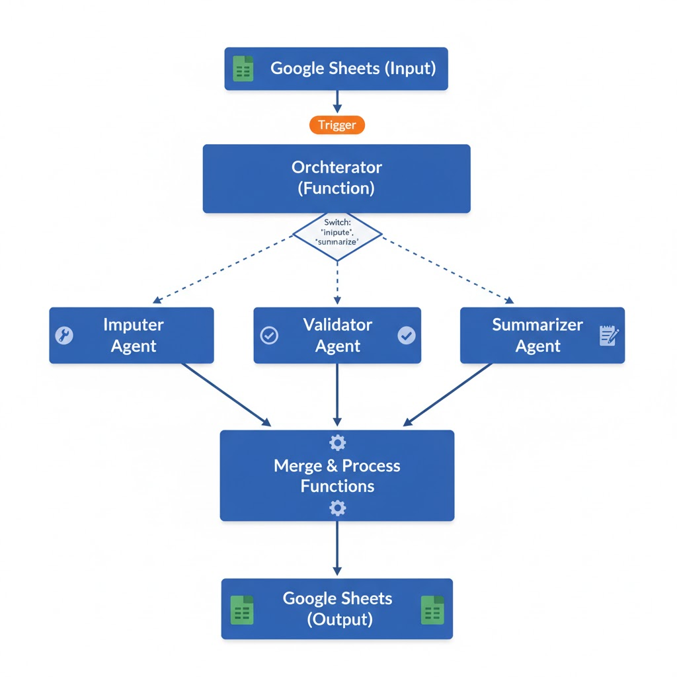
High-Level Architecture

Slide 5
Technologies Used
n8n: Automation & orchestration platform.
Google Sheets API: Data input and output.
LLMs via Hugging Face:
Llama-3.2-1B-Instruct for imputation/validation.
BART-Large-CNN for summarization.
JavaScript Function Nodes for data processing and merging.

Slide 6
Future Enhancements
Integration with Vector Databases for memory retrieval.
Real-time dashboards for monitoring cleaning statistics.
Add auto-detection of new data schemas.
Support for multiple data sources beyond Google Sheets.

